Slide 1

Midterm semester project presentation
Automated propeller geometry measurement from 3d scanning data
LIS
Supervisors :
S. Steffen
A. Bhaskaran
Author:
P. Maury Laribière

Slide 2
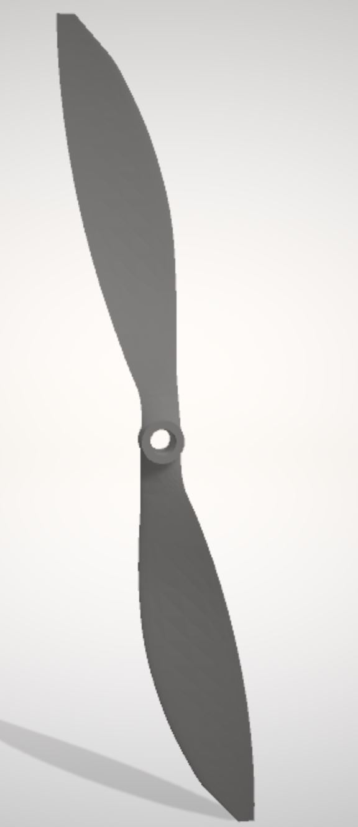
Introduction : Drones performance analysis
Summary :
Introduction
State of art
Goal of the project
Method
Done
To be done
Conclusion
Fig.1: Propeller STL file from 3D scanning

Slide 3
Introduction: State of the art 3D Scanning
1. Contact
2. Non Contact Active
3. Non Contact Passive
CMM
Structured Light
Time of flight
Laser triangulation
Photgrammetry
5 main techniques

Slide 4
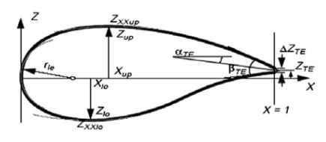
Introduction: State of the art Aerofoil parametrizations
Bézier
Parsec
Bésier - Parsec
Sobieczky (with PARSEC)
Improved Parameter Geometric
Fig 2: PARSEC parametrization parameters
From Airfoil Parameterization Techniques: A Review,
Nilesh P. Salunke, Juned Ahamad R. A.2, S.A. Channiwala2

Slide 5
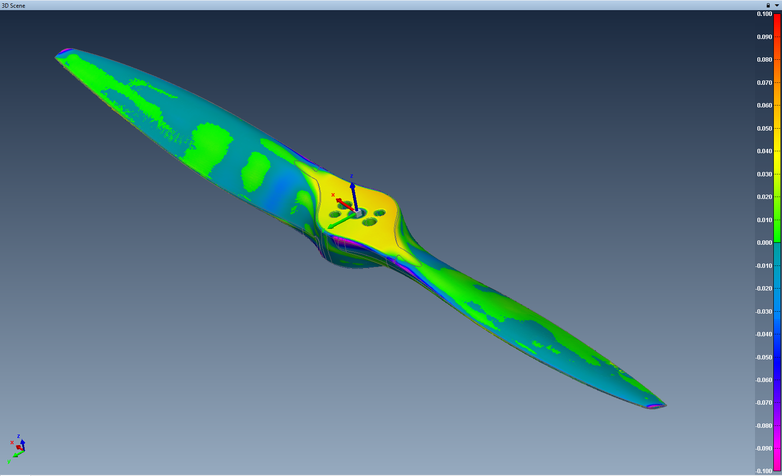
Introduction: Goal of the project
3D scanning technologies
Developed in past years
No automated method
Automated method from 3D scanning
Wind Tunnels
Blade Elementum Theory

Slide 6
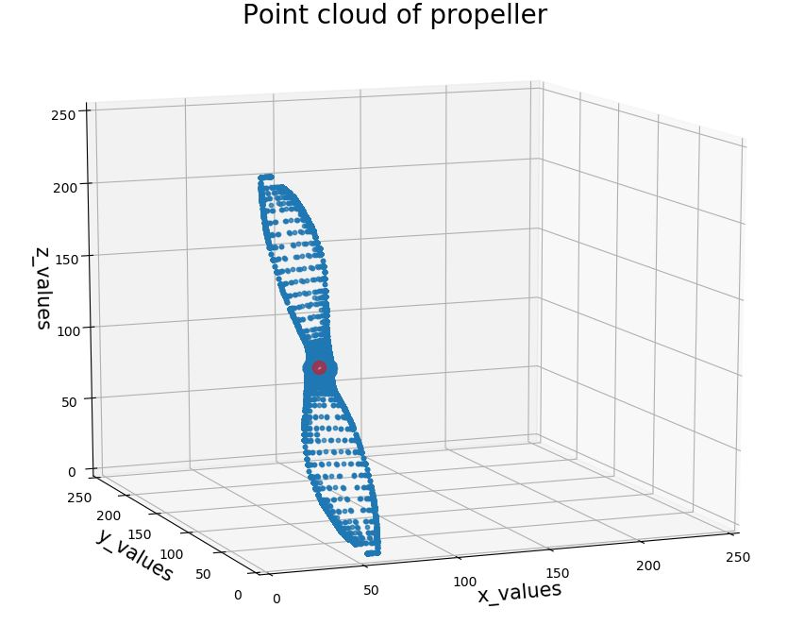
Introduction: Goal of the project 3D data scanning : Propeller geometry measurement
Reverse engineering aerodynamics of propellers
Point cloud processing
Projections for Xfoil software
Parameters
Fig.3: Point cloud of propeller

Slide 7
Methodology : Algorithm Done
Steps :
Pre-processing
STL to CSV
Main directions
Find equation of planes
File segmentation
Projection
From upper or lower side
Projection
From interpolation of both sides

Slide 8
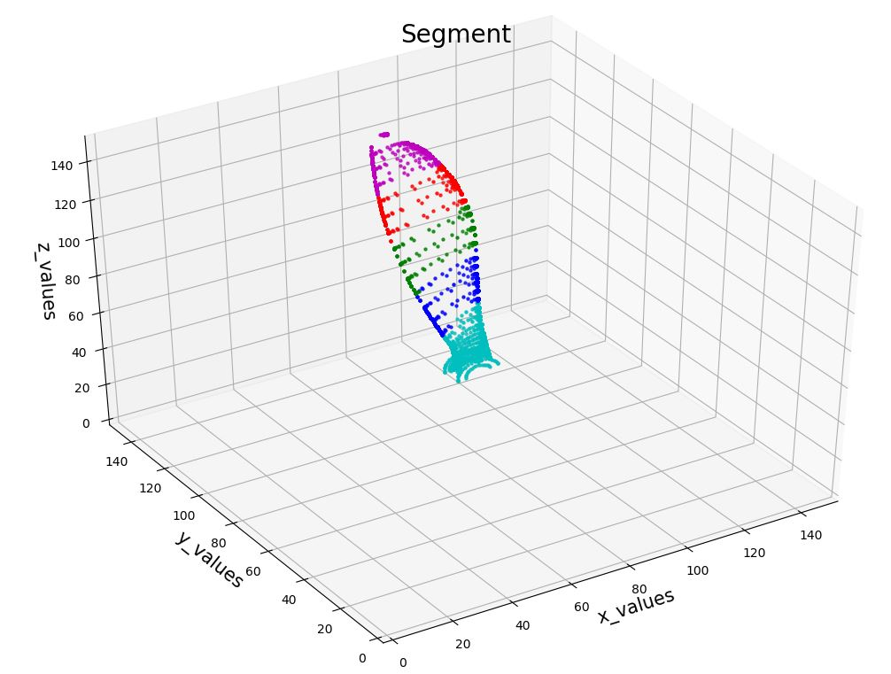
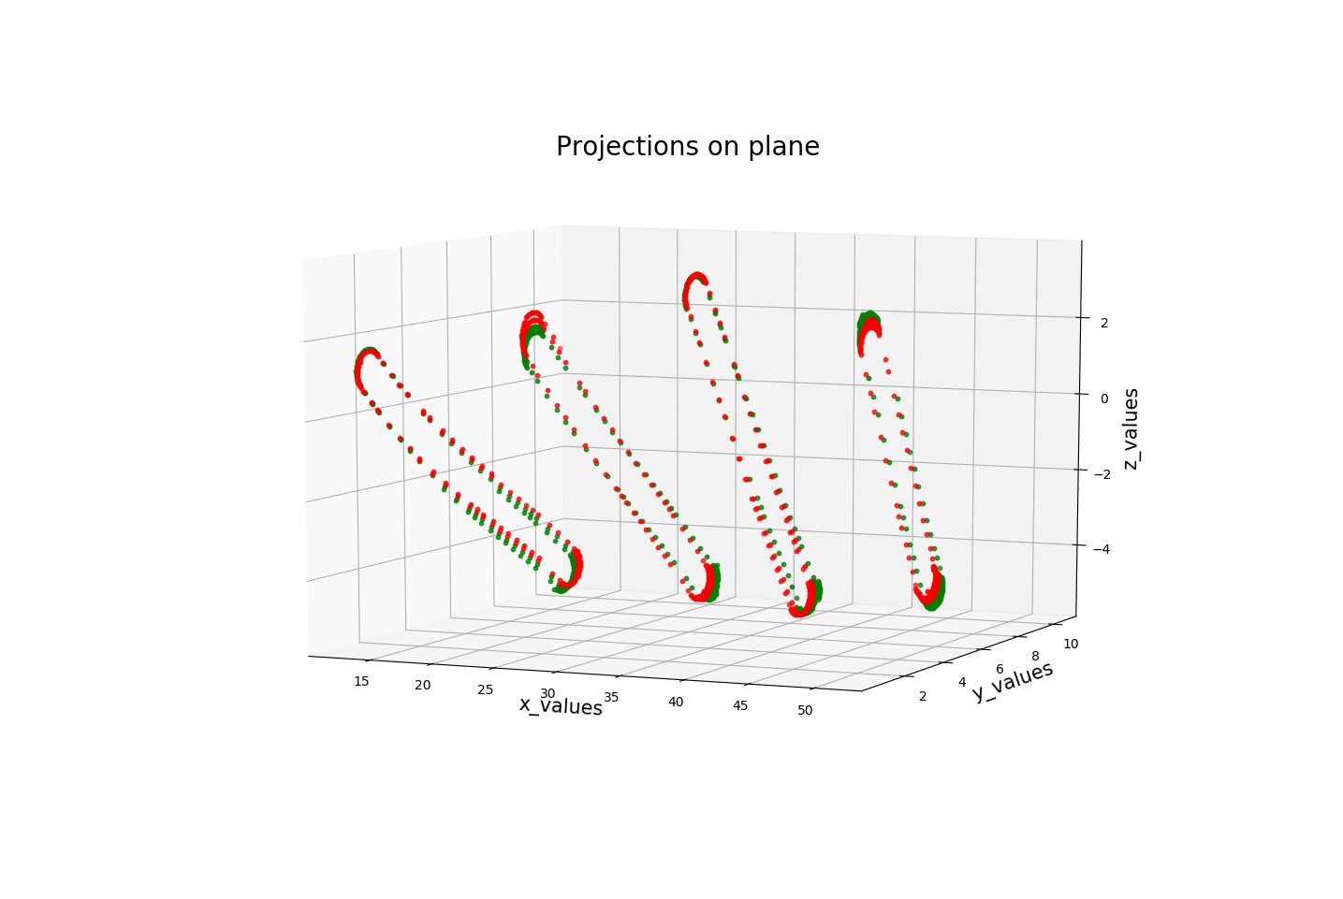
Methodology : Algorithm Done
Segmentation
Fig.4: Segments of propeller
Fig.5: Projections on plane

Slide 9
Methodology : Algorithm To be done
Projections
Find interpolation
Parameters
Hub radius
Tip radius
3D scanning
Automation of method
X-foil software
Lift and drag
Blade twist
Chord length

Slide 10
Conclusion
Issue : How to project (pair of points) ?
3D scanning data (reverse engineering) : Very promising
Many choices :
Parametrizations of propellers
Scanning methods

Slide 11
Thank you for your attention

